Slide 1
Crimes in Chicago
Hadoop & MapReduce Project 4
Group 4: Geetish Nayak
Sherry Shi
Jyoti Yadav
Purvi Bafna

Slide 2
Datasets
Crimes-small.csv: 21.34MB
Replaced “,” by “$” in the file to avoid problems when separating columns by “,”
Crimes_2001_to_present.csv:1.335GB
Used the raw dataset as the size was large.

Slide 3
Question 1: Most dangerous neighborhoods
Based on Community Area, consider Arrest == ‘false’
grunt> A = LOAD 'Crimes_2001_to_present.csv' USING PigStorage(',') AS (ID: chararray, CaseNumber: chararray, Date: chararray, Block: chararray, IUCR: int, PrimaryType: chararray, Description: chararray, LocationDescription: chararray, Arrest: charArray, Domestic: chararray, Beat: int, District: int, Ward: int, CommunityArea: int, FBICode: chararray, XCoordinate: double, YCoordinate: double, Year: int);
grunt> B = FILTER A BY Arrest == ’false';
grunt> C = GROUP B BY CommunityArea;
grunt> D = FOREACH C GENERATE group, COUNT(B.Arrest) AS Mycount;
grunt> E = ORDER D BY Mycount DESC;
grunt> DUMP E
Results:
The most dangerous neighborhood is Community 25. And when used small dataset, the number of crimes is 170259. In the large dataset, the output gives a value as “(,415112)”. This could be because the dataset is not pre-processes or there could be null values in community areas.

Slide 4
Question 1: Most dangerous neighborhoods
(,415112)
(25,170259)
(43,111682)
(24,108296)
(8,103924)
(67,96198)
(71,93506)
(28,90546)
(68,88231)
(23,86792)
(49,86593)
(66,83148)
(69,80614)
(22,78778)
(29,77023)
(6,71049)
(44,69325)
(32,66529)
(19,63914)
(61,62764)
(46,62378)
(7,60148)
(53,56651)
(30,52505)
(42,51537)
(1,49874)
(27,48780)
(2,46679)
(38,44828)
(3,44789)
(26,44773)
(15,44606)
(16,41787)
(73,40094)
(21,34952)
(77,34217)
(40,33713)
(70,33605)
(58,33120)
(31,30903)
(63,30787)
(14,29860)
(35,29007)
(56,28317)
(75,27846)
(65,26125)
(4,25217)
(60,24218)
(17,23888)
(41,23666)
(51,22335)
(5,22206)
(33,21525)
(39,20130)
(48,20079)
(20,20013)
(76,18442)
(45,18057)
(52,17724)
(10,15862)
(64,15546)
(11,15032)
(59,14710)
(54,14318)
(72,14307)
(62,14254)
(50,12950)
(57,12876)
(34,12332)
(13,11915)
(18,9584)
(37,9425)
(74,8021)
(55,7984)
(36,7544)
(12,7261)
(47,5368)
(9,3857)
(0,65)

Slide 5
Question 1: Most dangerous neighborhoods
Based on Community Area, consider all crimes as the total number of crimes that happened
grunt> A = LOAD 'Crimes_2001_to_present.csv' USING PigStorage(',') AS (ID: chararray, CaseNumber: chararray, Date: chararray, Block: chararray, IUCR: int, PrimaryType: chararray, Description: chararray, LocationDescription: chararray, Arrest: charArray, Domestic: chararray, Beat: int, District: int, Ward: int, CommunityArea: int, FBICode: chararray, XCoordinate: double, YCoordinate: double, Year: int);
grunt> B = GROUP A BY CommunityArea;
grunt> C = FOREACH B GENERATE group, COUNT(A.CommunityArea) AS Mycount;
grunt> D = ORDER C BY Mycount DESC;
grunt> DUMP D
Results:
The most dangerous neighborhood is also Community 25. Using the small dataset, the number of crimes comes out to be 304612 .

Slide 6
Question 2: most dangerous month for each crime type
Query:
grunt> A = LOAD 'Crimes_2001_to_present.csv' USING PigStorage(',') AS (ID:chararray,CaseNumber:chararray,Date:chararray,Block:chararray,IUCR:int,PrimaryType:chararray,Description:chararray, LocationDescription:chararray, Arrest:chararray, Domestic:chararray);
grunt> B = FILTER A BY Arrest == 'true' OR Arrest == 'false';
grunt> C = FOREACH B GENERATE PrimaryType,SUBSTRING(Date,0,INDEXOF(Date,'/',0)) AS Month;
grunt> D = GROUP C BY (PrimaryType,Month);
grunt> E = FOREACH D GENERATE FLATTEN($0) AS (PrimaryType, Month),COUNT(C) AS cnt;
grunt> F = GROUP E BY PrimaryType;
grunt> G = FOREACH F GENERATE group,MAX(E.cnt);
grunt> H = JOIN G BY ($0,$1), E BY ($0,$2);
grunt> I = FOREACH H GENERATE $0,$3,$4;

Slide 7
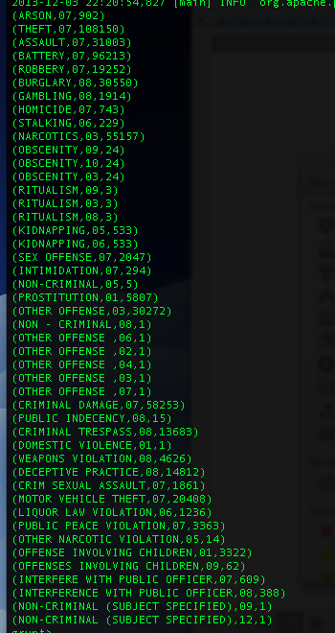
Question 2: most dangerous month for each crime type
Results:

Slide 8
Question 3: growth for each crime type
Growth = (Number of crimes in next year – Number of crimes in current year)/Number of crimes in current year
For example:
Growth = (crimes in 2002 – crimes in 2001)/(crimes in 2001)

Slide 9
Question 3: growth for each crime type
Query: Take 2001 and 2002 as an example
grunt> A = LOAD 'Crimes_2001_to_present.csv' USING PigStorage(',') AS (ID: chararray, CaseNumber: chararray, Date: chararray, Block: chararray, IUCR: int, PrimaryType: chararray, Description: chararray, LocationDescription: chararray, Arrest: charArray, Domestic: chararray, Beat: int, District: int, Ward: int, CommunityArea: int, FBICode: chararray, XCoordinate: double, YCoordinate: double, Year: int);
grunt> B = FILTER A BY Arrest == 'true' OR Arrest == 'false';
grunt> C = FOREACH B GENERATE PrimaryType,Year;
grunt> D = GROUP C BY (PrimaryType,Year);
grunt> E = FOREACH D GENERATE FLATTEN($0) AS (PrimaryType,Year), COUNT(C) AS cnt;
grunt> F = FILTER E BY Year==2001;
grunt> G = FILTER E BY Year==2002;
grunt> H = JOIN F BY $0,G BY $0;
grunt> I = FOREACH H GENERATE $0,(DOUBLE)(((DOUBLE)$5 - (DOUBLE)$2)/(DOUBLE)$2);

Slide 10
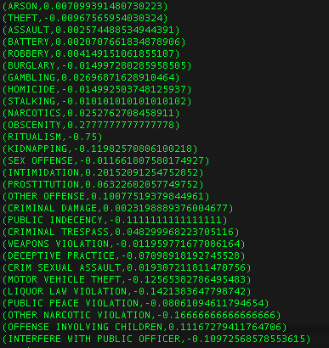
Question 3: growth for each crime type
Resullt:

Slide 11
Question 4: most dangerous time period for each crime type
Extract Hour from “Date” use SUBSTRING
Divided 24 hours into 4 time periods:
Morning: >= 6 AND < 12
Afternoon: >= 12 AND < 18
Evening: >= 18 AND < 24
Night: >= 0 and < 6

Slide 12
Question 4: most dangerous time period for each crime type
Query:
grunt> A = LOAD 'Crimes_2001_to_present.csv' USING PigStorage(',') AS (ID: chararray, CaseNumber: chararray, Date: chararray, Block: chararray, IUCR: int, PrimaryType: chararray, Description: chararray, LocationDescription: chararray, Arrest: charArray, Domestic: chararray, Beat: int, District: int, Ward: int, CommunityArea: int, FBICode: chararray, XCoordinate: double, YCoordinate: double, Year: int);
grunt> B = FILTER A BY Arrest==‘true’ OR Arrest==‘false’;
grunt> C = FOREACH B GENERATE PrimaryType,(INT) SUBSTRING(Date, INDEXOF(Date,' ',1),INDEXOF(Date,':',0)) AS Hour;
grunt> D1 = FILTER C BY Hour >= 6 AND Hour < 12;
grunt> Morning = FOREACH D1 GENERATE $0, $1, 'morning' AS TimeOfDay;
grunt> D2 = FILTER C BY Hour >= 12 AND Hour < 18;
grunt> Afternoon = FOREACH D2 GENERATE $0, $1, 'afternoon' AS TimeOfDay;
grunt> D3 = FILTER C BY Hour >= 18 AND Hour < 24;
grunt> Evening = FOREACH D3 GENERATE $0, $1, 'evening' AS TimeOfDay;
grunt> D4 = FILTER C BY Hour >= 0 AND Hour < 6;
grunt> Night = FOREACH D4 GENERATE $0, $1, 'night' AS TimeOfDay;
grunt> E = UNION Morning, Afternoon, Evening, Night;
grunt> F = GROUP E BY (PrimaryType, TimeOfDay);
grunt> G = FOREACH F GENERATE FLATTEN($0) AS (PrimaryType, TimeOfDay),COUNT(E) AS cnt;
grunt> H = GROUP G BY PrimaryType;
grunt> I = FOREACH H GENERATE group, MAX(G.cnt);
grunt> J = JOIN I BY ($0, $1), G BY ($0, $2);
grunt> K = FOREACH J GENERATE $0,$3,$4;

Slide 13
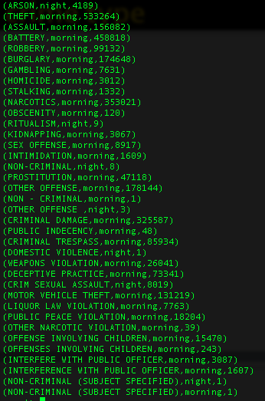
Question 4: most dangerous time period for each crime type
Result:

Slide 14
Question 5: crime type that most difficult to arrest
Query:
grunt> bt = LOAD 'Crimes_2001_to_present.csv' USING PigStorage(',') AS (ID: chararray, CaseNumber: chararray, Date: chararray, Block: chararray, IUCR: int, PrimaryType: chararray, Description: chararray, LocationDescription: chararray, Arrest: charArray, Domestic: chararray, Beat: int, District: int, Ward: int, CommunityArea: int, FBICode: chararray, XCoordinate: double, YCoordinate: double, Year: int);
grunt> btfAf = FILTER bt BY Arrest == 'false';
grunt> btfAfgP = GROUP btfAf BY PrimaryType;
grunt> btfAfgPCount = FOREACH btfAfgP GENERATE $0,COUNT(btfAf);
grunt> btgP = GROUP bt BY PrimaryType;
grunt> btgPCount = FOREACH btgP GENERATE $0,COUNT(bt);
grunt> btFinalJOIN = JOIN btgPCount BY $0, btfAfgPCount BY $0;
grunt> btFinal = FOREACH btFinalJOIN GENERATE $0,(DOUBLE)((DOUBLE)$3/(DOUBLE)$1);
grunt> btFinalSorted = ORDER btFinal BY $1 DESC;

Slide 15
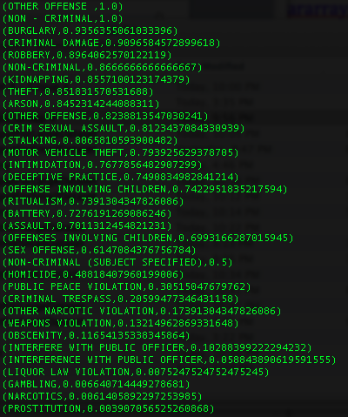
Question 5: crime type that most difficult to arrest
Result:

Slide 16
Question 6:UDF
We wrote a UDF in java to filter the headers from the dataset. The class name is FilterHeader, and we made a jar file called filter.jar.
We used the UDF to answer Q3

Slide 17
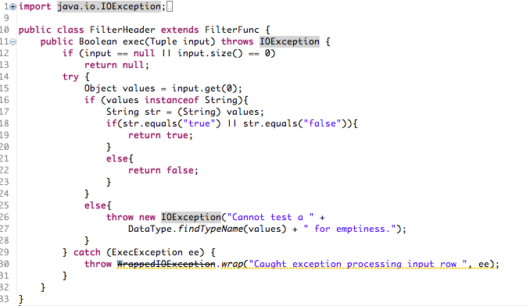
Question 6:UDF

Slide 18
Question 6:UDF
Query
grunt> REGISTER filter.jar
grunt> A = LOAD 'Crimes_2001_to_present.csv' USING PigStorage(',') AS (ID: chararray, CaseNumber: chararray, Date: chararray, Block: chararray, IUCR: int, PrimaryType: chararray, Description: chararray, LocationDescription: chararray, Arrest: charArray, Domestic: chararray, Beat: int, District: int, Ward: int, CommunityArea: int, FBICode: chararray, XCoordinate: double, YCoordinate: double, Year: int);
grunt> B = FILTER A BY FilterHeader(Arrest);
grunt> C = FOREACH B GENERATE PrimaryType,Year;
grunt> D = GROUP C BY (PrimaryType,Year);
grunt> E = FOREACH D GENERATE FLATTEN($0) AS (PrimaryType,Year), COUNT(C) AS cnt;
grunt> F = FILTER E BY Year==2001;
grunt> G = FILTER E BY Year==2002;
grunt> H = JOIN F BY $0,G BY $0;
grunt> I = FOREACH H GENERATE $0,(DOUBLE)(((DOUBLE)$5 - (DOUBLE)$2)/(DOUBLE)$2);
grunt> dump I

Slide 19
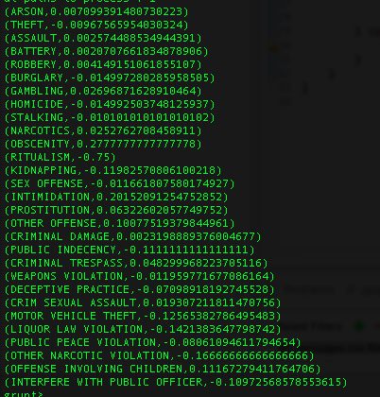
Question 6:UDF
Result:
The same result with Q3

Slide 20
Question 7: Microsoft SQL Server
Query:
SELECT T2.PT2, Mon
FROM
(
(SELECT [Primary Type] PT1,MAX(Cnt1) AS Cnt1
FROM( SELECT [Primary Type], SUBSTRING(Date,0,CHARINDEX('/',Date,0)) AS Mon, COUNT(1) AS Cnt1
FROM [Hadoop_ChicagoCrime].[dbo].[Chicago_Crime]
GROUP BY [Primary Type], SUBSTRING(Date,0,CHARINDEX('/',Date,0))) AS T1
GROUP BY [Primary Type])
LEFTOUTER JOIN
(SELECT [Primary Type] PT2, SUBSTRING(Date,0,CHARINDEX('/',Date,0)) AS Mon, COUNT(1) AS Cnt
FROM [Hadoop_ChicagoCrime].[dbo].[Chicago_Crime]
GROUP BY [Primary Type], SUBSTRING(Date,0,CHARINDEX('/',Date,0))) AS T2
ON Cnt = Cnt1 AND PT1=PT2
)
ORDER BY PT2

Slide 21
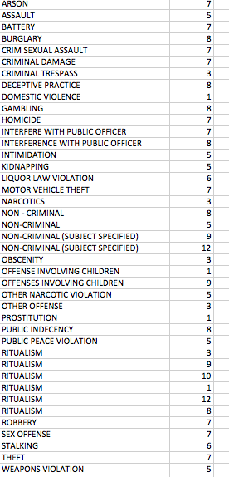
Question 7: Microsoft SQL Server
Result:

Slide 22
Question 7: Microsoft SQL Server
Analysis:
The same result with Q2
We used both datasets
Time to run the small dataset using SQL Server is almost zero seconds, while time using Pig is 57 seconds.
Time to run the large dataset using SQL Server is 75 seconds, while time using Pig is 113 seconds.

Slide 23
THANK YOU

